Slide 1
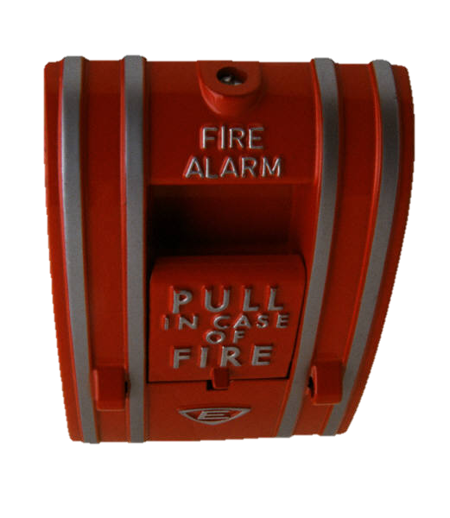
Campus Safety
Notes:
Module 5 Lesson 2
Unless otherwise specified, all clip art and images in this document are used with permission from Microsoft in accordance with their End User License Agreement.

Slide 2
Campus Safety Resources
College campuses provide many types of safety resources to protect students.
Police/Public Safety officers
Campus patrols
Security cameras
Emergency alert systems
Emergency “blue light” call boxes
After-hours transportation or escorts
Safety and lockdown plans for critical situations
Self-defense training and safety education
Notes:
The specific safety precautions you need to take and the safety procedures you need to follow will differ depending on what your college campus is like. However, most campuses share some significant commonalities in their safety resources and the tips that will keep you safe.
College campuses generally have a wide variety of safety resources designed to protect the people on campus, prevent crime, and handle emergencies. Some of those resources are listed here.
Most campuses have a dedicated police or public safety force. At some campuses, these are sworn police officers with the same duties, rights, and responsibilities as the local police force. The campus police generally handle any matters arising in their jurisdiction (on campus), whether it’s a speeding ticket, an underage drinking violation, a felony crime like rape, or anything in between. They also often do educational and outreach programs.
Campus patrols may be conducted by the police/public safety force, but there also may be a volunteer student safety patrol organization.
Many campuses have security cameras both inside buildings and outside on campus.
Emergency alert systems may include multiple ways of notifying students, faculty, staff, and the community in emergency or urgent situations. This could include some/all of the following components: a campus siren/loudspeaker; an email alert; a text-message or phone call alert; public-address system announcements in buildings; and more. These alerts could be activated for anything from a tornado warning to an armed gunman.
Many college campuses have strategically-located emergency “blue light” call boxes, cleverly named after the blue lights on top of them. These call boxes are designed to immediately patch the person activating them through to the campus police at the touch of a single button.
Transportation or safety escorts are often available after dark.
Each campus has a number of different emergency plans in place that go into effect in the event of specific critical situations. These plans often tie into the emergency alert system to let students, faculty, staff, and visitors know what to do while the police and first responders stabilize the situation.
As part of their mission to prevent crime, many campuses also offer various safety education training, programs, and events for students, faculty, and staff. These may include things like self-defense training, alcohol/drug awareness, sexual assault awareness, registration/identification of valuables (e.g., engraving identifying number on your laptop in case it’s stolen), and personal safety seminars.

Slide 3

Campus Safety Tips
Notes:
Even with all the safety resources a campus may provide, it is critical for students to exercise caution and practice smart safety habits. Many students quickly come to feel at-home and safe on campus, and in fact, most college campuses are relatively safe places to be. However, falling into a false sense of invulnerability makes you a potential target. Keeping the following tips in mind when you’re on campus will help make your campus experience safer. In addition, these tips work best when they are used in conjunction with each other.
List of the categories of tips we will be discussing in this lesson:
Lock your doors and valuables
Use the buddy system
Travel safely on campus
Use the emergency “blue lights”
Carry your cell phone
Make smart decisions

Slide 4
Lock your Doors and Valuables
Always lock your doors
  Dorm rooms
  Entry doors to residence halls
  Car doors
Protect your valuables
  Get a bike lock and use it consistently
  Do not bring unnecessary valuables to campus
  Don’t carry around anything you can’t afford to lose
  Store valuables in a lockbox
  Insure your valuables
Notes:
One of the most important tips for personal safety on campus is to always lock up.
This includes your doors, first and foremost.
The door to your room or suite should be kept locked, and your campus living department may even have a rule or guideline about keeping doors closed and locked.
This also applies to the main entry door to your residence hall. Many residence halls have electronic access cards or fobs that are set to only allow residents to open the main doors. In these cases, the doors automatically lock behind you. However be aware of whether the door locks immediately upon closing or whether the lock takes another few seconds to engage. There’s a practice called “tailgating” or “piggybacking” in which people who don’t belong in a building wait for a person with a key to enter and then follow them in before the door locks to gain access to the building. Tailgating can be an awkward situation because the social pressure to be polite and hold the door open for someone coming in behind you is significant. However, this is one situation where it is absolutely appropriate to let safety override manners. Unless you are 100% certain that the person trying to tailgate is a permanent resident of the building, do not let them in! A little social awkwardness could be the difference in deterring a crime.
Finally, be sure to lock your car doors as soon as you get into your car and keep them locked unless someone is getting in or out. If you have a car that automatically locks the doors when you shift out of park or reach a certain speed, don’t rely solely on that system. Get in the habit of locking the door as soon as you close it.
The other category of things to lock up is your valuables.
If you’re taking a bike to campus, the first thing you need is a good lock. Find out what kind of lock the campus police department recommends and get that type. Then find out the most effective way to use it and get in the habit of consistently locking your bike up that way. It may take an extra minute to lock your bike up the right way, but with how common bike theft is on campuses, it’s well worth that time.
When it comes to other valuable items, think long and hard about whether you really need to bring them to campus. Obviously there are some expensive items that have to come with you, such as your laptop, cell phone, etc. However consider whether you can do without some of the other items you’re planning to bring. Good examples include jewelry, cameras, game consoles, other electronics, musical or sports equipment, etc. If you have a less valuable alternative, bring that instead. (e.g., leave your “prized possession” guitar at home and bring your old “practice” guitar with you.)
A corollary to the previous rule is that if you do bring something to campus, don’t carry it around with you unless you can afford to lose it. For example, if you’re an avid photographer and have a really nice camera, leave it locked up in your dorm room unless you’re actively using it. This also includes things like cash, personal documents (birth certificate, social security card, etc.), and credit cards/debit cards. If it’s locked up, it’s harder to lose! Plus, carrying much cash around makes you a potential target.
Finally, for the valuables that you bring to campus, make sure you have a lockbox in your room. You can find relatively inexpensive, locking, fireproof boxes or miniature safes that are small enough to store in your room but large enough to hold your valuables. More importantly, they’re heavy enough to be inconvenient for a thief to grab them and run, not to mention conspicuous to see being carried across campus. Alternatives to the lockbox/mini-safe are a locking trunk/footlocker or at least a small locking file cabinet.
Finally, have your parents help you find out whether the items you bring to campus are still covered by their homeowner’s insurance or renter’s insurance. Policies differ in whether items stored outside of the home are covered, and you may want to look into purchasing a separate renter’s insurance policy if you have anything really valuable that won’t be covered by your parents’ policy while you’re at school. These policies usually are inexpensive, easy to set up, and provide peace of mind in case anything does go missing.

Slide 5

Use the Buddy System
Never walk anywhere alone after dark
Larger groups (three or more people) are the safest way to travel on campus
Develop a buddy system with a few friends
Make it a habit to tell someone…
  Where you’re going
  Who you will be with
  When you plan to return
at library
til 12
Notes:
Another crucially important way to keep yourself safe on campus is to use the buddy system anytime you’re walking somewhere after dark. The more people you can have in your group, the better. Don’t be shy about developing a buddy system with a group of friends and acquaintances. If you all look out for each other, there will always be someone to accompany you when you need to run an errand or park your car after dark, because they know you’ll be there for them when the roles are reversed. This is one situation where it pays to be persistent in seeking out a buddy, since it could very well make a difference in deterring a crime.
When students go to college, their new independence can be very liberating. They don’t have to tell their parents where they are going or check in with anyone anymore. However, as a new college student, it is critical for you to understand the importance of letting someone know where you are going, who you are going with, and when you plan to return. Your roommate is a great person to share this information with. If you set up a system at the beginning of the year where you each keep the other posted on your whereabouts, you know you’ll always have someone who knows to look for you if you don’t turn up when expected. You don’t even have to be overly specific, as long as someone has a general idea of where you are in case something does happen.

Slide 6
Travel Safely on Campus
Be observant. Pay attention to your surroundings at all times – even in broad daylight
Keep the volume on headphones low enough to hear what’s going on around you
Walk with confidence and awareness
Plan your route before you leave
Stay in well-lit and populated areas after dark
Take a personal safety class
Notes:
In addition to the buddy system, here are more tips for how to travel safely on your campus.
Be observant. Most people are oblivious to their surroundings because their minds are elsewhere. Being on a college campus can lull students into a false sense of security, but it’s important to learn to pay attention to where you are and what people are doing around you. Don’t assume that this only applies after dark or in certain areas. These habits should be practiced whether you’re standing within sight of 3 police officers in the safest part of town in broad daylight or at 4 am in an abandoned warehouse in a high-crime neighborhood. (Although really, just don’t go to any abandoned warehouses at 4am.)
Remember that being observant happens with your ears too, not just your eyes. If you’re listening to music while walking around campus, don’t drown out the sounds around you. You should be able to hear your surroundings no matter where you are.
Another aspect of safe travel is to look confident and aware of your surroundings. It’s not enough to be aware…looking like you are aware is important too. Studies have shown (**see below for source) that criminals choose victims who appear unconfident and distracted. Walking with purpose, alertness, and confidence can lead to a criminal passing you over for an easier target.
This next tip is related to walking confidently and is particularly relevant during the time period when you’re still getting your bearings on campus. Until you know the campus like the back of your hand, it’s all too easy to get turned around, confused, or lost while walking from one place to another. Before you leave, make sure you know where you’re going and the best route to get there. Looking confused or lost or stopping to get your bearings can make you a potential target, so be sure that you look like you know where you’re going, even if you’re not sure.
Of course, choosing the safest route is also part of this. After dark, it’s important to choose routes that take you through well-lit areas where there are likely to be the most people around. Shortcuts can be tempting when you’re in a hurry, but a longer route full of potential witnesses is likely to be much safer.
Finally, most campuses offer a basic safety protection class that will teach self-awareness and escape skills. Taking one of these is a good idea and can provide you with additional information specific to your own campus.
**Source of information about criminals’ choice of victims: Hustmyre, C. & Dixit, J. (2009). Marked for mayhem. Psychology Today. Retrieved from http://www.psychologytoday.com/articles/200812/marked-mayhem

Slide 7
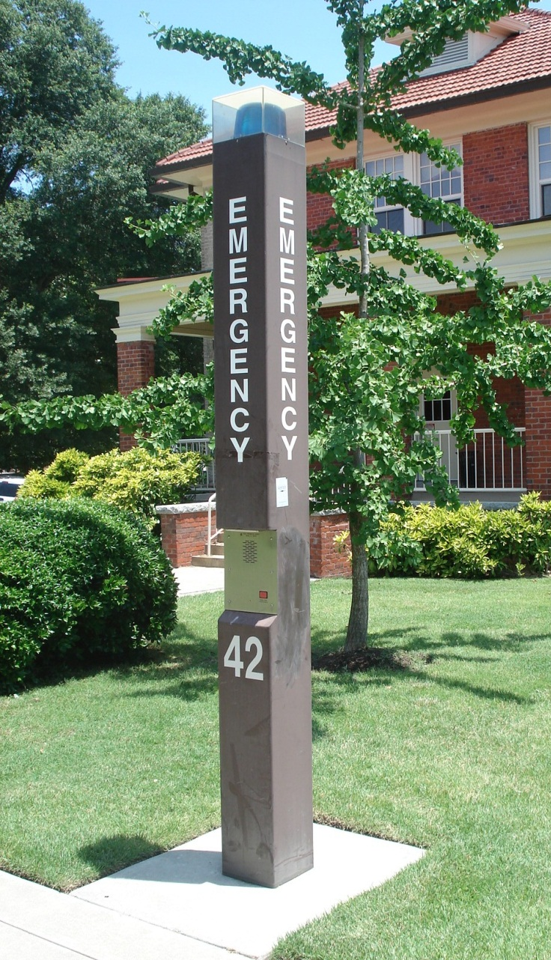
Emergency “Blue Lights”
Emergency call button that connects directly to the campus police
Note the locations of these lights on your campus
Don’t be afraid to use them
If you don’t feel safe standing near an emergency light, press the button and keep moving toward the next one
Notes:
Most campuses have emergency “blue light” call boxes strategically located throughout the campus. These lights have an emergency call button that connects directly to the campus police station along with a speaker that lets you talk to a dispatch operator. When you push the button, it alerts the dispatcher the specific location of the blue light that’s been activated, and on many campuses, the nearest police officer is immediately notified and dispatched to that location. At the same time, you can speak to the operator through the speaker.
Virtually every campus tour, orientation session, and other introductory event mentions these call boxes, so pay attention when they’re pointed out so you know what they look like on your campus. As you get acquainted with campus, note where the lights are located so you’ll have a basic mental map of them in case you ever need help.
Although the lights should not be abused, it’s important to know that they’ve been installed specifically for the purpose of helping students. You shouldn’t hesitate to use them anytime you need assistance from campus police. Students sometimes assume that they must be reserved only for the most dire of emergencies. However, you can and should use these lights for any type of emergency or urgent situation when you need campus police involved.
One more thing to keep in mind is that if you feel unsafe stopping at a blue light to wait for the police to arrive – for example, if you believe that you’re being followed – then you can simply press the button on the blue light and keep walking. These call boxes are often located fairly close to each other, so you can continue on to the next one and press that button as you walk by as well. The police will use the order in which you activate the call boxes to figure out where you’re headed and catch up with you.
(The photo on this slide is of an emergency “blue light” call box on the campus of East Carolina University. Photo credit: Emily Johnson)

Slide 8

Carry Your Cell Phone
Always carry your cell phone
Develop a habit of charging it regularly
Save emergency phone numbers in your contacts and designate an ICE contact
Don’t count on having access to your phone or contacts in an emergency; carry a small card listing important phone numbers
Notes:
A very basic safety measure is to always make sure you have your cell phone with you. For most students, remembering their cell phone isn’t the problem – remembering to keep the battery charged is. To ensure it’s charged when you need it, get into a habit of plugging it in at a specific time every day, like before you go to bed at night. You may also want to consider keeping a spare charger with a car adapter in your car.
Before you get to college, program all the emergency phone numbers you might need into your phone. This includes typical ones like the campus police and local police, but also make sure you have numbers for a crisis hotline, local hospital or urgent care center, student health center, student counseling center, after-hours campus transportation or safety escort, local taxi company, and others you can think of. Also take a moment to designate one of your contacts as “ICE” in your phone. This stands for “In Case of Emergency” and indicates to first responders or other authorities who they should contact first if something happens to you. College students usually designate their parents as their ICE contacts, but if you have another close relative or friend who lives near your school, they might be a good choice as well.
Although it may sound contradictory to what we’ve just said, at the same time, don’t count on having your phone in an emergency. You should have a backup plan that doesn’t rely on being able to access your contacts list if something happens. A good way to handle this is to create a wallet-sized reference card that includes emergency phone numbers and any other information you might urgently need. You can keep a copy in your wallet, car, backpack, etc. – anywhere you might be able to access it quickly.

Slide 9
Make Smart Decisions
Avoiding unsafe situations is the best prevention
Choose your friends carefully
Don’t go anywhere with people you do not know and trust
Trust your instincts!
Socialize responsibly and in moderation.
Remember that the consequences of your decisions can follow you for a lifetime.
Notes:
Finally, a lot of personal safety on campus boils down to making smart decisions. The best way to prevent problems is to avoid putting yourself in situations that have a high potential to be unsafe.
The people you spend time with have a big influence over your safety. Choosing your friends and acquaintances wisely goes a long way towards staying safe. Plus, if you and your friends are all looking out for each other, each of you can help the others to make smart decisions that won’t put any of you at unnecessary risk. This applies to the social situations you put yourself into. If you don’t know and trust someone, don’t go with them. If you feel uncomfortable or awkward saying that you don’t want to do something or go somewhere because you don’t feel safe with the people involved, then make up an excuse. Although honesty is the best policy in a lot of situations, there is absolutely nothing wrong with using a “little white lie” to remove yourself from a situation you feel might be unsafe. Don’t let your desire to avoid social awkwardness or discomfort put you in danger.
In making decisions about safety, sometimes you will need to simply trust your instincts. Listen to that little voice or alarm bells in your head that alert you to potential danger. If you have a gut feeling that something isn’t right, pay attention to it! Humans have evolved with instincts designed to keep us alive. If your gut is telling you to watch out, there’s probably a good reason for it, even if you can’t figure out exactly what it is.
*(See disclaimer below.) Finally, although the main purpose of college is to further develop your intellectual and academic side, there’s nothing wrong with using this experience to grow in social and recreational pursuits as well. In other words, college is – and should be – a lot of fun. You’ll have plenty of time to enjoy social situations, and you should take advantage of those opportunities. However, you need to do this responsibly and in moderation. When you get to campus, pay attention to the safety tips you get about how to party safely. You might be surprised to learn that some of the students with the most active social lives are also those who follow the most rigorous safety guidelines. Having a great time in college does not have to include getting intoxicated to the point of making unsafe choices – nor does it have to mean staying stone-cold sober in order to make safe choices. You can achieve a balance of fun and safety no matter how you like to have fun in college.
Furthermore, a good guideline to keep in mind is that the consequences of the decisions you make on a daily basis in college can have long-lasting repercussions that will follow you for the rest of your life. Making safe, smart choices now benefits you both now and in the future.
(*Disclaimer* Please note that the authors do not intend to convey approval of underage drinking or of any kind of illegal drug use. Based on current statistics about alcohol and other drug use on college campuses, we feel it is important to acknowledge the idea of partying responsibly and in moderation when discussing safety issues with students instead of assuming that all students will abstain from these activities.)

Slide 10
Campus Safety Video
Watch this video from the University of Illinois
at Urbana-Champaign about how
to stay safe on campus.
Campus Safety Video
Notes:
The University of Illinois at Urbana-Champaign has a very informative video about campus safety. It is around 15 minutes long.
http://www.odos.uiuc.edu/safety/safety.html
Note: Some of the information discussed in the video is covered in this curriculum’s module about Technology in lessons/activities about internet safety, instead of within this module.

Slide 11
This work is licensed under a Creative Commons Attribution-NonCommercial 3.0 Unported License.

