Slide 1
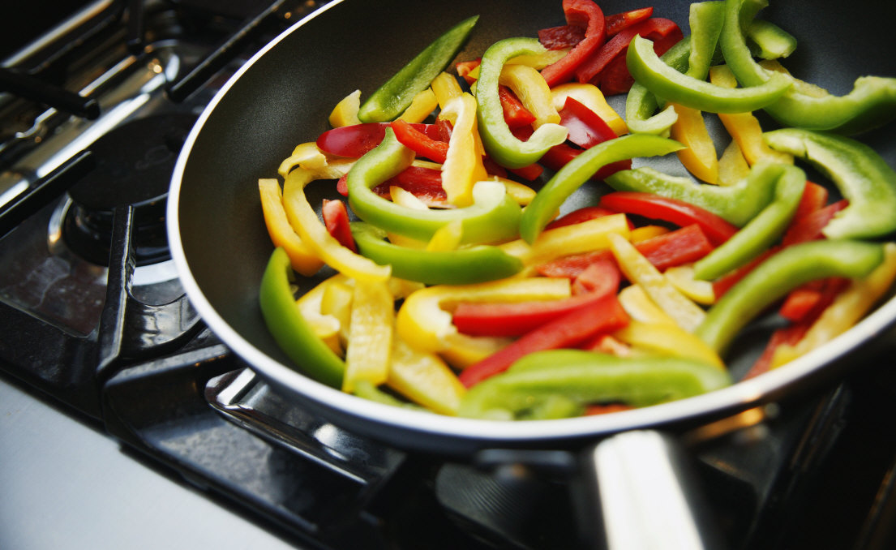
Basic Cooking
Notes:
Module 5 Activity 1
In this activity, students will learn how to cook a simple meal and will reflect on the experience.
(In-Class Discussion)
Even though many first-year college students rarely cook because they have meal plans, cooking is still an important skill to develop before they leave. Any college student who lives off-campus is likely to need to cook on a somewhat regular basis.
Unless otherwise specified, all clip art and images in this document are used with permission from Microsoft in accordance with their End User License Agreement.

Slide 2
Cooking 101
Basic cooking skills
Understanding basic nutrition and identifying healthy meal options
Following simple recipes and understanding cooking instructions and terms
Learning about food safety and kitchen safety
If you do not already have these skills, start hanging around the kitchen and asking questions when your family prepares meals!
Notes:
Students don’t need to become gourmet chefs before they go to college; generally some basic cooking skills will suffice.

Slide 3
Cooking Activity
Ask your parent (or whoever cooks in your family) to help you choose a nutritious meal to cook for your family.
Prepare and serve the meal on your own (with a little guidance as needed).
Do not forget that cleaning up after yourself is part of cooking!
After cooking your meal, add the menu, recipes, and ingredient list(s) to your journal.
Notes:
(Student Homework Assignment)
It is likely that the students in the class will have varying levels of skill with cooking. Some may cook meals for themselves or their families on a regular basis – others may have hardly ever used a stove. This activity can be adapted for any skill level. For example, students who have more experience may not need parental guidance to get started; those with less experience may need to be walked through the entire process by their parent.

Slide 4
Journal Entry
Reflect on the experience of cooking your meal.
What meal did you select and why?
Was this a nutritious meal? Why or why not?
What did you learn?
How did taking on this responsibility impact you?
What was your family’s reaction to your meal?
What are some other meals that you could learn to prepare before going to college?
Notes:
Allow the students to choose the format for their journal entry:
Typed or hand written journal
Video journal
Audio-recorded journal
Comic illustration with captions
Etc.
Extension Activity: Each student brings in a recipe that includes instructions and an ingredient list. Make a class “cook book” of inexpensive meals that use limited and nutritious ingredients.
Students can also log their time and activities in the kitchen as they work to increase their cooking skills.

Slide 5
This work is licensed under a Creative Commons Attribution-NonCommercial 3.0 Unported License.

