Slide 1
Postsecondary Technology Tools for Learning
Notes:
Module 3 Lesson 2
Unless otherwise specified, all clip art and images in this document are used with permission from Microsoft in accordance with their End User License Agreement.

Slide 2
Why Is It Important?
AT helps students with learning differences be more successful in college.
Students report that AT resources help them learn more effectively and efficiently, making learning less stressful.
Students who use AT in high school are more likely to use AT in college.
Notes:
Review of technology items discussed in Module 3 Lesson 1 and segue to the connection of learning the academic and personal applications of assistive technology and the impact they will have on the students’ educational experience.

Slide 3
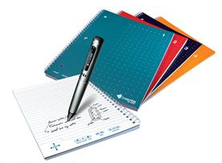
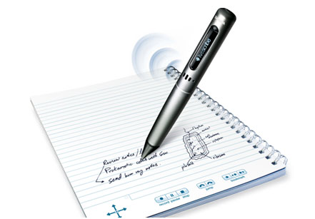
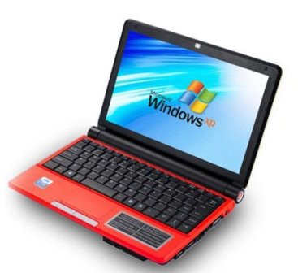
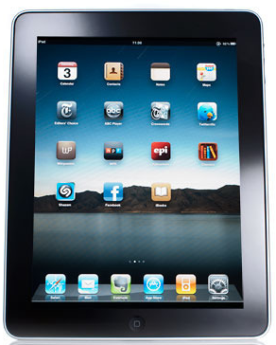
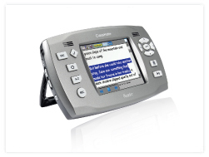
Let’s Explore!
Notes:
There are many different brands and kinds of assistive technology available today. Some products, such as iPads, are usually bought for entertainment but can be used for AT purposes.

Slide 4
Speech-to-Text Software
Install on your computer
You talk, it types
Example: Dragon Naturally Speaking
Watch the demo online
Notes:
View the demonstration video and discuss.
http://www.nuance.com/videoplayer/videoplayer.asp?n=Nuance_DNS_11_Launch_100_640x360&w=640&h=360&p=naturallySpeaking/product-demos/&autoPlay=false&videoPage=true

Slide 5
Smart Pens
Ballpoint pen with embedded digital audio recorder
Synchronizes written notes on special paper with audio recording
Example: Livescribe
See it in action online (Scroll down and click on the videos.)
Notes:
View the demonstration video and discuss.
http://www.livescribe.com/en-us/

Slide 6
Text-to-Speech Software
Install on your computer and control via floating taskbar
Reads text aloud to you
Many other features such as dictionary, phonetic spell checker, screen masking, and converting to mp3 files
Example: textHELP
Learn more online
Notes:
View the demonstration video and discuss.
http://www.texthelp.com/videotours/rw10marketing/intro/intro_stream_us.html

Slide 7
Classmate
Portable audio book player
Reads aloud while highlighting text on screen
Includes integrated dictionary, voice or text notes, highlighting, and bookmarking passages
Watch the guided tour online Click on Features/Specs; scroll down and click the guided tour link in the right margin
Notes:
View the demonstration video and discuss.
http://www.humanware.com/en-usa/products/learning_disabilities/_details/id_107/classmate__reader.html

Slide 8
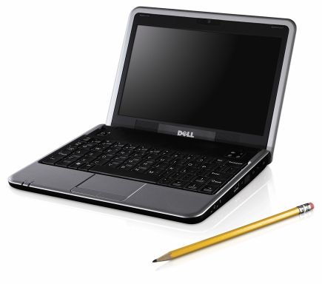
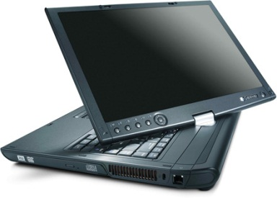
Laptop Computers
Netbook
Tablet PC
Smaller and lighter than a traditional laptop to increase portability
Less power and fewer features than traditional laptop, with focus on basic functions
Display panel swivels and folds down to allow touchscreen interface
Stylus input allows for handwriting on screen instead of typing
Notes:
Brief discussion of key points.

Slide 9
Portable Tablets
Smaller and lighter than laptops and netbooks to increase portability
Numerous apps for different types of supports as needed
Notes:
Brief discussion of key points.

Slide 10
Research Select one of the following AT items to explore on your own and share with class in the next session.
iPod
iPad
Audio recorder
Smart pens
Netbooks
Smartphone
Speech-to-text software
Inspiration graphic organizer software
Other
Notes:
Students should choose one brand/type of AT and research the uses and advantages of that product. They will need to include the following:
Description of the product
Ways it supports learning
Skills needed to use the product
Possible challenges it can present
Cool Factor (what makes this AT really attractive to users)

Slide 11
This work is licensed under a Creative Commons Attribution-NonCommercial 3.0 Unported License.

